Slide 1

The tanishq controversy
Varun Khadayate A016

Slide 2
What's the ad about

Slide 3
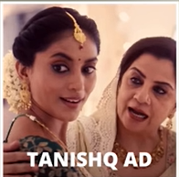
AD about Tanishq Ekatvam Series
A Hindu lady getting married in a Muslim family
A ceremony of Baby Shower(Godh-Bharai)
The lady ask mother in law its not in your tradition…
She tells but to make the girl happy tradition is there…

Slide 4

Arguments opposing

Slide 5

Netizens slamming it for promoting inter-faith marriages.
Some asked why isn’t it the other way round.
Promoting a particular Faith only
Wrong release date

Slide 6
Arguments Supporting

Slide 7

An AD is all about aspirational stuff
No one is going to make a life decision by seeing this ad
The idea behind the Ekatvam campaign is to celebrate the coming together of people from different walks of life.

Slide 8

the aftermath

Slide 9
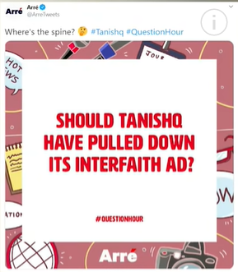
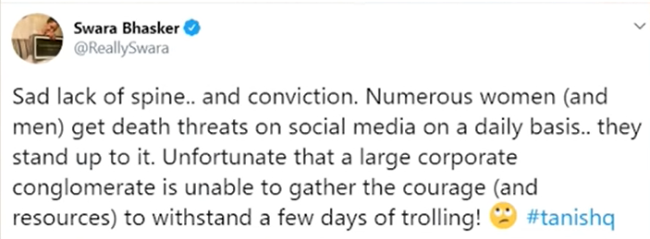
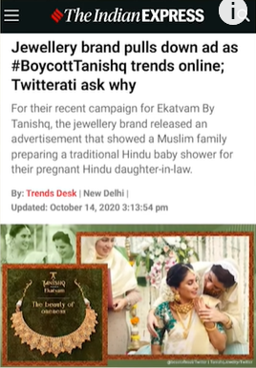
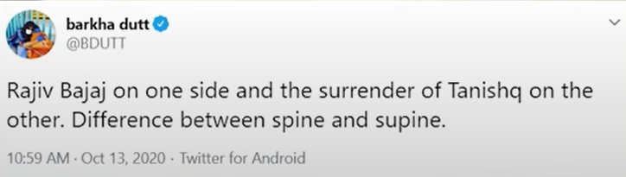
AD got a lot of dislikes rather than likes on YouTube.
The authorities finally deleted the AD.
Many reactions came after that
Don't have a back bone
Tata Group is spine less
Feared from digital lynching
Even Compared it with terrorist.

Slide 10
CONCLUSION
A company's interest in their consumer cannot be limited to their product category or brand anymore. Advertisers must understand what their customers' beliefs and opinions are concerning politics, society or life in general. They must mindful of how they are processing any message that a brand gives out and how it will be decoded.
These are important to listen to with care.
Brand pragmatism is the need of the day, not brand idealism.

Slide 11

THANK YOU

